Slide 1
Modern Languages for
Life and Work Award

Slide 2
Aims
To review the existing award at SCQF levels 3-6
To provide an overview of the award at SCQF level 7
To outline the supporting documentation
To provide an overview of the Assessment Support Packs

Slide 3
Background
Modern Languages for Work Purposes unit has existed since 2008 at SCQF levels 3-7
Modern Languages for Life unit has existed since 2012 at SCQF levels 3 and 4
Alternative means of certification
Available in 10 languages
Candidates can be presented for individual
units or the whole award

Slide 4
Structure of the Award
Award consists of three units at SCQF level 3-7
Modern Languages for Life
Modern Languages for Work Purposes
Additional freestanding unit from Wider Achievement suite of awards

Slide 5
SCQF level 3 and 4
Modern Languages for Life
Modern Languages for Work Purposes
Build your Own Employability Skills
Level of language as for National 3 and 4

Slide 6
SCQF level 5 and 6
Modern Languages for Life
Modern Languages for Work Purposes
Leadership: an introduction
Level of language as for National 5 and Higher

Slide 7
SCQF level 7
Modern Languages for Life
Modern Languages for Work Purposes
Personal Enterprise Skills
Level of language as for Advanced Higher

Slide 8
Documentation
Group Award Specification for each level with support notes
Unit Specification for each level with support notes
Assessment Support Packs (Generic, French, Spanish)
Summary of Assessment Support Packs and topics covered on SQA Secure

Slide 9
Group Award Specification
One for each SCQF level
Aims, purpose, structure
Mapping of Core Skills
Assessment strategy
Information for learners
Topic areas
Approaches to delivery and assessment
Examples of assessment opportunities
How to combine assessments at levels 3 and 4

Slide 10
Unit specification
Outcomes and performance criteria
Evidence requirements
Assessment strategy
Suggested topic areas
Approaches to delivery and assessment
Examples of assessment opportunities
How to combine assessments at levels 3 and 4
Information for learners

Slide 11
Assessment support packs
Combined and freestanding packs
Summary of assessment activities matched to outcomes
Assessment conditions and evidence to be gathered
Instruments of assessment in Word
Judging Evidence Tables
Example of talking checklist
Recording documentation

Slide 12
Assessment Support Packs
French, Spanish and Generic ASPs at SCQF level 3-7 for Modern Languages for Life
French, Spanish and Generic ASPs at SCQF level 3-6 for Modern Languages for Work Purposes
Generic pack for Modern Languages for Work Purposes at SCQF level 7

Slide 13
Modern Languages for Life
SCQF level 7 – topic areas in current ASPs
Lifestyles
Stereotypes and prejudice
Media
Global citizenship
Sustainability
Travel and holidays
Planning for the future/education
Pastimes and interests

Slide 14
Modern Languages for Life
SCQF level 7- French exemplars
Ageism
Working from home
Mass tourism
Pollution/Global warming
Young people/employment/finances
Health and wellbeing

Slide 15
Modern Languages for Life SCQF level 7 – Spanish exemplars
Learning languages
Gap year
Young people/employment/finances
Sustainable tourism
Studying abroad

Slide 16
Modern Languages for Work Purposes – topic areas in current ASPs
Duties and responsibilities
Part-time jobs and work experience
Citizenship
Voluntary work
Career paths
Equality in the workplace
Future plans and ambitions

Slide 17
Modern Languages for Work Purposes SCQF level 7 - exemplars
Impact of an ageing population
Working from home
Mass tourism
Global warming
Young people and employment
Health and wellbeing

Slide 18
How to find documents
Group Award specifications - main Modern Languages web page, click on ‘Modern Languages for Life and Work Awards’ https://www.sqa.org.uk/sqa/57034.html
Unit specifications - Modern Languages for Life and Work Awards page : type in the unit code into ‘unit search’
Assessment Support Packs - SQA secure site, under ‘Awards’ https://secure.sqa.org.uk/secure/Awards/Modern_Languages_for_Life_and_Work_Award

Slide 19
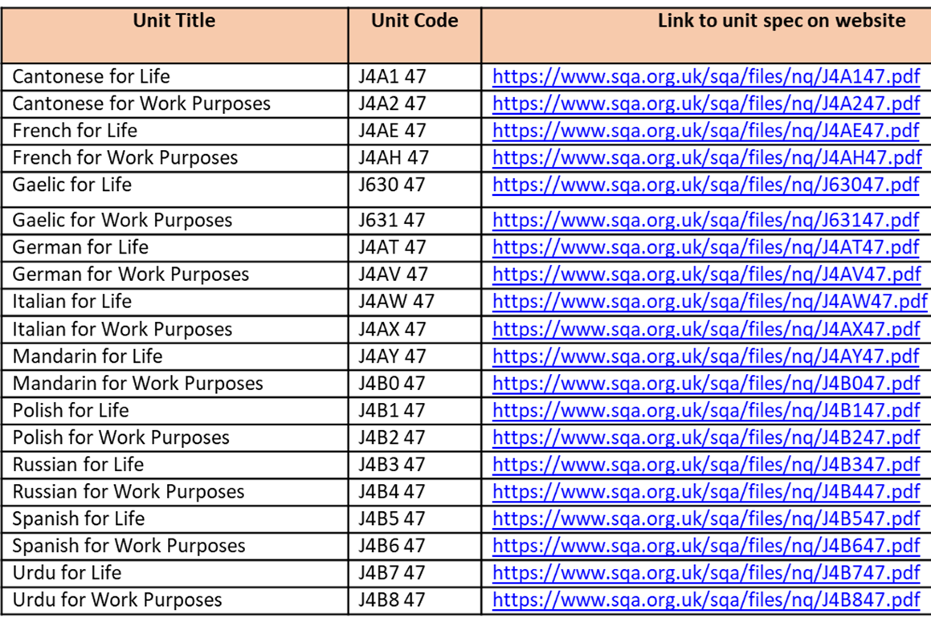
Unit Codes

Slide 20
Assessment exemplars
French for Life Exemplar C – Mass Tourism
Modern Languages for Work Purposes Exemplar C – Mass tourism
Spanish for Life Exemplar B – Gap year
Modern Languages for Work Purposes Exemplar E - Young people and employment

Slide 21
Any questions?

Slide 22
janette.kelso@sqa.org.uk
lorna.mcmurray@sqa.org.uk

